Slide 1
Threat/Risk Modeling and Sharing
What is it and what will it do for me?
May 2014

Slide 2
Motivation
Threat information sharing critical enabler for ‘wire-speed’ defense of complex systems
Information sharing requires shared concepts for subject area
NIEM is used by US federal, state, and local government, as well as internationally
STIX is being adopted by a large number of users
Snort rules are common for IDS
Multiple protocols, languages, and models used throughout industry today, but:
Re-use of existing protocols for threat exchange (e.g. IODef)
Focus on threat indicators/signature and classification (e.g. STIX, OpenIOC)
Desire to have traceability from indicators to threat actors and their motivation/intent
Leverage existing work performed by social modeling and behavior groups, e.g. SI*
Some integration with other enterprise systems, but no comprehensive approach

Slide 3
Approach (Initial – at kick off)
Multi-Phase Approach
Start with initial mapping of existing concepts (STIX Data Model <-> NIEM UML Profile
Develop meta-model for threat modeling and expand scope
Include non-cyber domains
Include creation of Platform Independent Model (PIM) and Platform Specific Models (PSM) that represent STIX, OpenIOC
Include social model of threat actors, campaigns, motivation
E.g. through leveraging SI* framework concepts
Integrate with
NIEM 3.0
Common Alerting Protocol (CAP)
Other applicable systems
Extend beyond cyber threat sharing
Non-cyber domain integration
Sharing of countermeasure for specific threats

Slide 4
Phase 1 (Initial – at kick off)
Create “Cyber Domain PIM” utilizing UML Profile for NIEM to model STIX information exchange
NIEM profile exists today
STIX has currently richest model and broadest interest base
Expected output: Specification that includes
Cyber Domain PIM
STIX PSM
Rationale: fairly easy to achieve, concretization of a Cyber Domain PIM that can serve as basis for meta-model or semantic models for other platforms

Slide 5
Status
Threat Modeling project kicked off in Dec 2013
Multi-phase approach
Initially: create Cyber Domain PIM and STIX PSM with UML Profile for NIEM
Expand to non-cyber domains and inclusion of risk
Evolution of thinking
Team moves to a conceptual modeling approach covering situational awareness across multiple kinds of threats and risks (not just Cyber)
Progress so far
Provided preliminary UML version of STIX, identified STIX primary concepts
Developed initial conceptual threat model
Some basic mappings from NIEM to STIX by ‘pivoting’ through conceptual model
Next steps
Expand conceptual model and solidify NIEM and STIX mappings
Identify additional information domains/sharing stacks for mapping
Explore additional use cases (including modeling and predictive analysis)
Integration with Risk Meta Model
Issue OMG-RFP
There are scope and “business case” directions being set as the team has evolved

Slide 6
Use Case: Large Company
Company with multiple datacenters, office facilities, international business activity
Large number of deployed security systems, sensors
Firewalls, IDS/IPS, SIEM, monitoring systems, notification/alerting, etc.
Uses FW/Snort rules, STIX/TAXII, IODef, alarms for fire and intrusions, etc.
Physical and information security staff, some 24/7
Interoperable (but not uniform) threat monitoring and assessment

Slide 7
Use Case – Critical Infrastructure
Target: A group of organizations that collaboratively manage critical infrastructure and utilize Industrial Control Systems.
Power, water and other critical infrastructure are threatened by cyber and physical terrorism.
Industrial Control Systems are increasingly computer controlled and connected (directly or indirectly) to the internet and may embed compromised control hardware/software from questionable sources.

Slide 8
Existing Interoperability No Common Meta Model
PT XML (notional)
Cap XML
Physical Threat Model
CAP (Model)
IODef (model)
Snort (model)
IODef (protocol)
STIX PIM
Snort rules
STIX XML
STIX JSON

Slide 9
Model for Semantic Interoperability Conceptual Domain Model
PT XML (notional)
Cap XML
Physical Threat Model
CAP (Model)
IODef (model)
Snort (model)
IODef (protocol)
STIX PIM
Snort rules
STIX XML
‘Semantic Glue’
(i.e. Conceptual Threat Model)
STIX JSON

Slide 10
High-Level Business Processes

Slide 11
Threat Actor Process

Slide 12
Defender Process

Slide 13
Information Sharing Process

Slide 14
Unify concepts across attackers
And defenders
Attackers
Defenders
Defense
Capability (TTP)
Informs understanding of
Attack Capability (TTP)
Attack Plan/MO
Course of action
Campaign
Incident
Defense
Plan (MO)
Strategy/Goal
Act
Acts on
Indicator
Bad Actor
Defense Strategy
Good Actor
Target
Observable

Slide 15
The scope question
At one end of the spectrum:
STIX/Cybox in NIEM, Full detail
Replicates STIX/Cybox level of detail
At the other end:
Situational awareness for threats and risks in general, across domains
Input summary information from cyber, law enforcement, natural disasters, etc.
Team’s trend

Slide 16
Current thought: Situational Awareness
Conceptual model covering threats & risks in general – Situational Awareness
Wide and thin conceptual model
Map (Complete)
Map (Summary Concepts)
NIEM
Threat/Risk
Model
Map (Replicate Concepts)
Map ( Summary Concepts)
STIX/TAXII
Other Cyber Related
…
CYBOX
CAP
Other Physical Related
…
Other Criminal
Related
…
Other Natural
Related
…

Slide 17
Cross-Protocol/Conceptual Model
Benefits
Reduce number of point-to-point interoperability connections; reduce interoperability from N² to linear problem
Enable uniform semantic interoperability
Communities continue driving development of specific threat models
Can support (map between) multiple exchange formats: NIEM, STIX and others
The conceptual model does not commit to any one physical format
Disadvantages
Translations will be lossy
Communities need focus to define mappings from specific model to meta model

Slide 18
Situational Awareness
Any
Threat/Risk
Situational
Awareness
Criminal
threats
Suspicious
Activity
Threat/Risk
Focus
Natural
threats
CAP
Physical
threats
A little extra for Cyber
STIX/TAXII
Leverages
STIX/Cybox
CYBOX
Cyber Only
Detail

Slide 19
Reasons for Current Direction
STIX is already providing for the Cyber use case for exchange of detailed and technology specific information between Cyber specialists.
A direct NIEM counterpart does not seem to be resonating with stakeholders as having a lot of value. It would also be large and detailed (as-is STIX/CYBOX)
There is no good solution for Situational awareness that federates multiple kinds of threats such as physical, cyber, natural, spectrum, criminal, etc.
It is difficult to think of threats without including risk, we should include Risk.
This seems a more natural fit for NIEM, would integrate with STIX (and others). It also addresses the core DHS mission, one of our sponsors.
The ability to address broad-based threats and risks based on a conceptual model avoids the “format wars”. It would provide additional value and reduces friction
A NIEM representation of general threat/risk situational awareness, mapped to the conceptual model, makes NIEM relevant in addressing address a critical need. It can then be extended that to more specific use cases as mission needs indicate.

Slide 20
Initial OMG RFP Focus
Wide & thin conceptual model covering threats and risks
High level Cyber-threat/risk concepts
Law Enforcement threats & risks
NIEM Threat/Risk EIEM
STIX/TAXII
Legion
Normative
Model/Mapping
NIEM Suspicious Activity
Input
(Informal mapping)
Normative Artifact
NIEM (Others)
Informative
mapping

Slide 21
Optional: Later Focus
Wide & thin conceptual model covering threats and risks
High level Cyber-threat/risk concepts
Law Enforcement threats & risks
More Detailed Cyber (Leverage STIX/Cybox concepts)
NIEM Threat/Risk EIEM
STIX/TAXII
NIEM Cyber Domain
NIEM Suspicious Activity
Needed level of detail still open to discussion based on requirements, no need to replicate STIX
NIEM (Others)

Slide 22
Pivoting Through a Conceptual Model
“Source”
Data
Representation
Data representations (Schema & Instances)
Model data for a purpose using a technology
“Instances” are data structures (e.g. SQL tables or XML documents) – “facts” about the things in the world from some perspective
Conceptual Domain Models (CDM)
A conception of the world by a group of stakeholders – less purpose specific
“Instances” are things in the world – so can’t be in models
Using abstraction, we can have multiple representations of facts about the world in different data structures and technologies
Rules define how domain concepts can be represented in a particular form – rules can be simple and generic or heavyweight and specific, depending on the representation.
“Target”
Data
Representation
Represent
Rules
Conceptual Domain Models
(Models of the world)

Slide 23
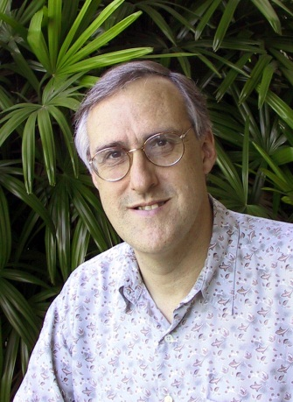
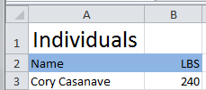

Example of “Pivoting” through a conceptual model
Concept of
“Cory Casanave”
There is an actual “Person”, Cory Casanave
There is a concept of this person shared in this room, right now
Here is one representation of him
“Person” is a shared concept, independent of data structures
There may also be shared agreement that Cory is a person and some other “facts”
“Cory Casanave” is a name for this person
He weighs 240 LBS
There are multiple data representations about Cory Casanave which may or may not agree
Those representations can be grounded in concepts (semantics), assisting federation
Concept of a
“Person”
<PersonType>
<NameText>Cory B. Casanave</NameText>
<Weight-LBS>234</Weight-LBS>
</PersonType>
XML
Representations
.
Excel
UML

Slide 24
Overview Models

Slide 25
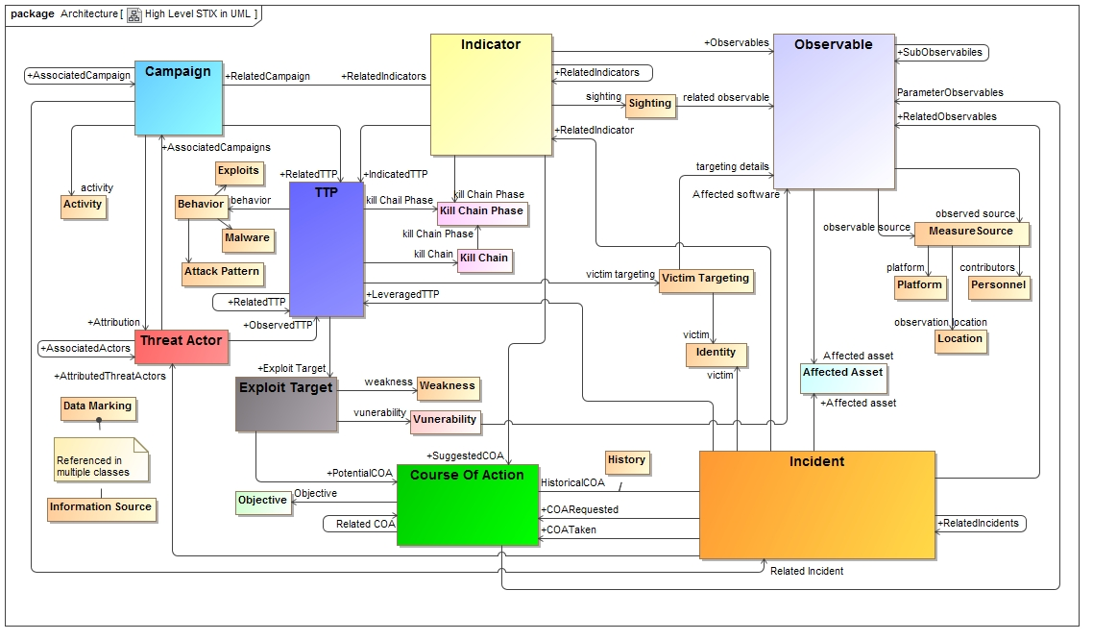
As-is STIX “Logical Level” in UML

Slide 26
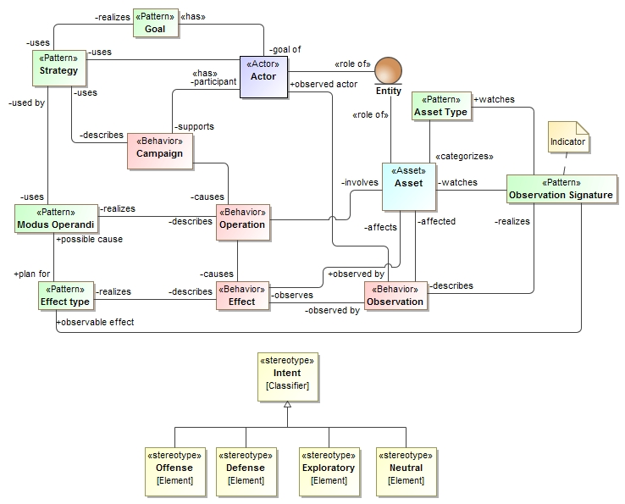
Current Conceptual Model Overview

Slide 27
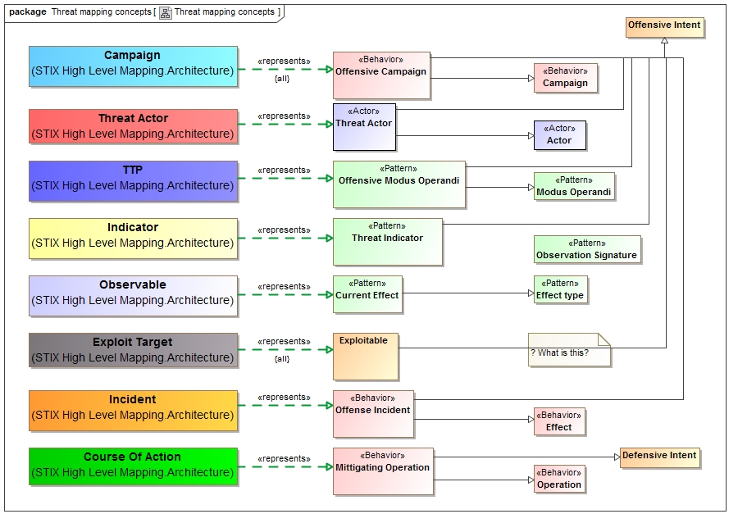
Mapping STIX and the conceptual Model

Slide 28
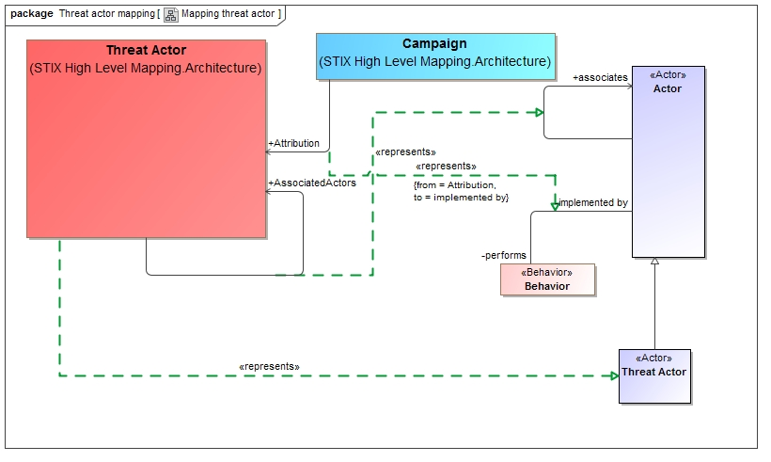
Example of lower level mapping

Slide 29
RFP

Slide 30
RFP Objective
In the broadest sense, organizations manage threats and risks in order to provide a systematic response to uncertainties. Multiple communities have developed data and exchange schema and interfaces for sharing information about threats, risks and incidents that impact important government, commercial and personal assets and privacy. While each of these schema and interfaces provides value for a specific community it is difficult to federate these multiple representations to arrive at broad-based, planning, simulation, assessment, situational awareness, forensics and to then enact the appropriate courses of action. Cyber related attacks have added a new dimension that stresses traditional mitigation strategies.
This RFP calls for a conceptual model for threats and risks that unifies the semantics of and can provide a bridge across multiple threat and risk schema and interfaces. The conceptual model will be informed by high-level concepts as defined by the Cyber domain, existing NIEM domains and other applicable domains, but is not specific to those domains. This will enable combined Cyber, physical, criminal and natural threats and risks to be federated, understood and responded to effectively.

Slide 31
Initial Focus
Wide & shallow conceptual model covering threats and risks
High level Cyber-threat/risk concepts
Law Enforcement / Emergence Management Concepts
NIEM Threat/Risk EIEM
STIX/TAXIICybox
SACM
ISO
NIST
Others…
Legion
Normative
(Formal Specification)
NIEM Exchanges
EDXL / CAP
Input
(Informal mapping)
Informative
mapping

Slide 32
RFP Requirements
Conceptual Models
Threat & Risk Concepts
Risk Assessment Concepts
Mitigation & courses of action
Risk & threat planning
NIEM representation & mapping
STIX/Cybox mapping
Common Requirements

Slide 33
RFP Non-Mandatory
Optional mappings
Optional support for conceptual modeling / mapping
Optional MOF representation

Slide 34
Additional Layer
Wide & shallow conceptual model covering threats and risks
Policy
Strategy & Planning
Operation & Execution
High level Cyber-threat/risk concepts
Law Enforcement / Emergence Management Concepts
NIEM Threat/Risk Representation
SACM
ISO
BMM
Others…
STIX/TAXII/Cybox
IODEF
ISO
NIST
Octave
Others…
NIEM Exchanges
EDXL / CAP
Financial – FIBO

